Slide 1
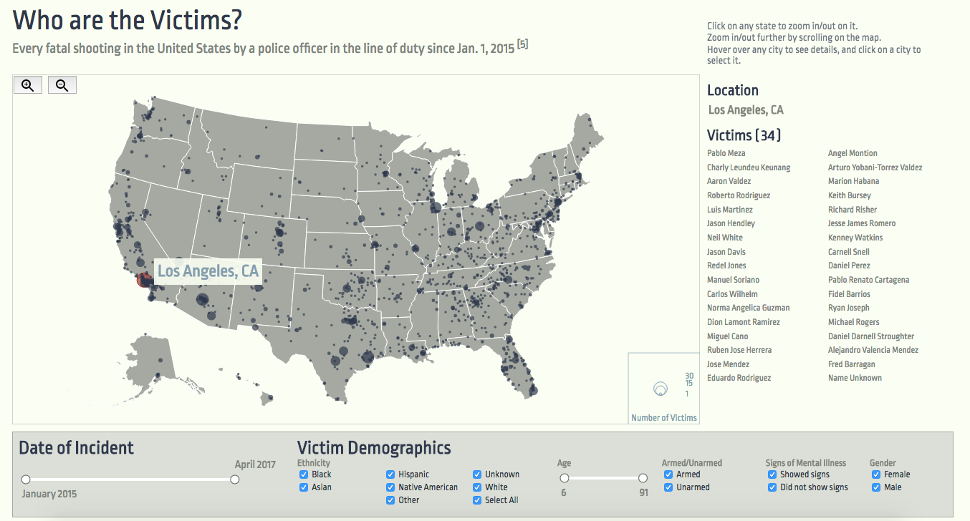
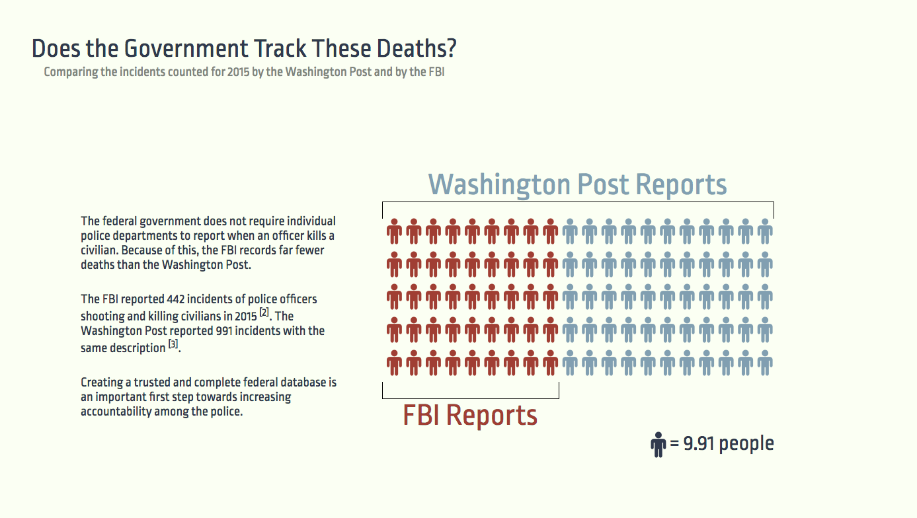
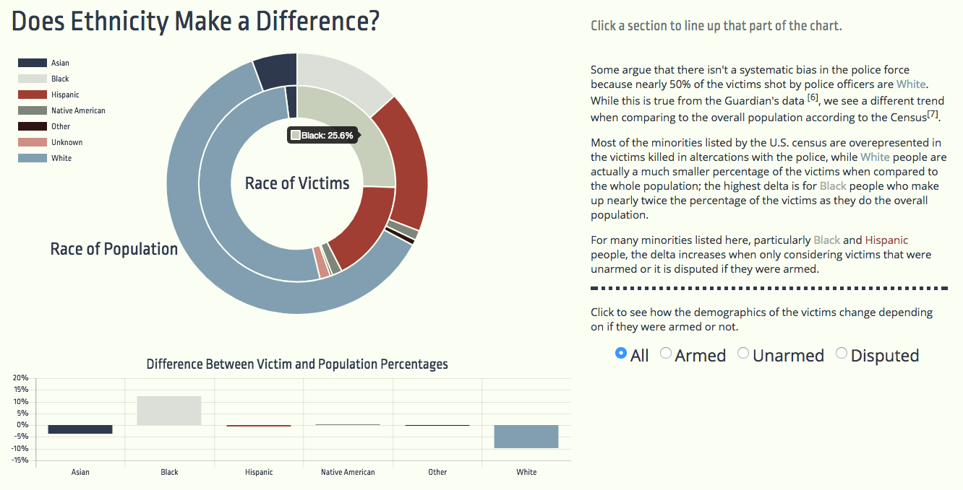
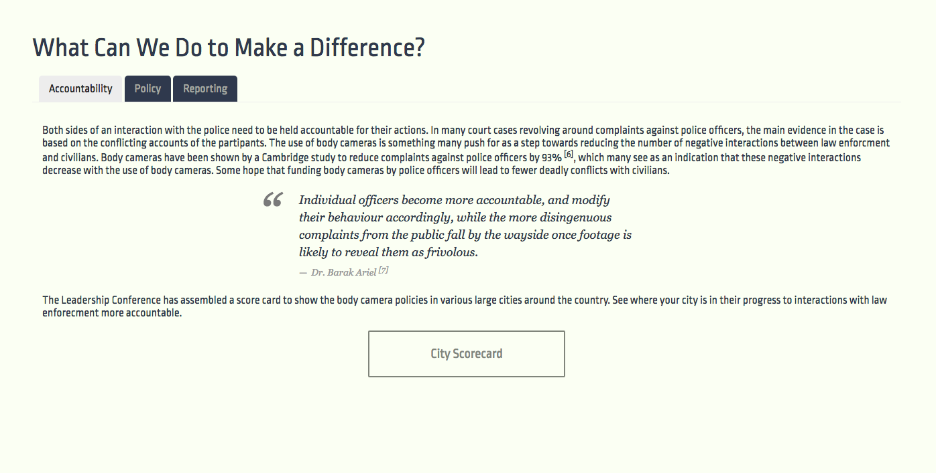

Police Killings in the US
On my honor, I will never betray my badge, my integrity, my character, or the public trust.
I will always have the courage to hold myself and others accountable for our actions.
I will always uphold the Constitution, the community, and the agency I serve, so help me God. - Law Enforcement Oath of Honor
Problem & Motivation
Results
Approach
The US has one of the highest rates of any country of civilian killings by police officers. Yet, there is no accurate federal database recording these incidents, no federal law or guideline on how individual departments should investigate these cases, and little movement towards actions that would increase officer accountability.
Our goal is to create an interactive data story about fatal police shootings in the United States. The Washington Post and the Guardian maintain detailed records of incidents of civilian fatalities caused by police. We use this data to visualize aggregate information about these fatalities and incorporate narrative elements to tell the stories of victims.
Envisioned users of our application include citizens, researchers, and others interested in learning more about this topic. In building our data story, we too would like to learn more about police fatalities, challenge our assumptions and discover insights that we can share with others.
We decided early on to use a data story, in that we wanted to create a hybrid of visualization and narrative to convey our message. When deciding on the topic of each individual visualization, we framed them with the question we wanted each to answer. These questions can now be seen as the title of each of our pages.
We tried to make these visualizations pleasing while also providing access to the underlying information. We also wanted to make each visualization very different from the others to add interest to the project.
Here we drive interest by focusing on one specific aspect of the data.
After providing some context for the data, we give users the ability to explore the data themselves. We chose a map for this section because we wanted to emphasize that this problem is countrywide. Users can filter the data to show only characteristics they are interested in, and can zoom in to make more detailed comparisons. It is also possible to search for a specific city, and hovering over cities and states lists the victims who were killed in that location.
Future work
Our work could be extended by adding more visualizations to our narrative. We would like to include information about recent legislation, and to compare the US with other countries.
This section is very data-heavy, especially in comparison to the previous section. We used nested donut charts because they are visually pleasing and make it easy to compare the distributions of race. Users can click on any section of the chart to align that race in the inner and outer donut. We double-encoded this difference to ensure that it is easily understood.
This final section provides information about actions that can be done to reduce the number of fatal shootings by police. The tab layout allows us to provide a lot of information while categorizing it in a meaningful way.
UW CSE 442 – June 5, 2017 - https://cse442-17s.github.io/Police-Killings-In-US/final/ - Meredith Lampe, Nick Mooney, Hunter Schafer, and Erika Wolfe
Notes:
TODO: Is sizing okay? Make room for narrative intro.

